Slide 1
Ernitec Video Wall installation Precautions

Slide 2
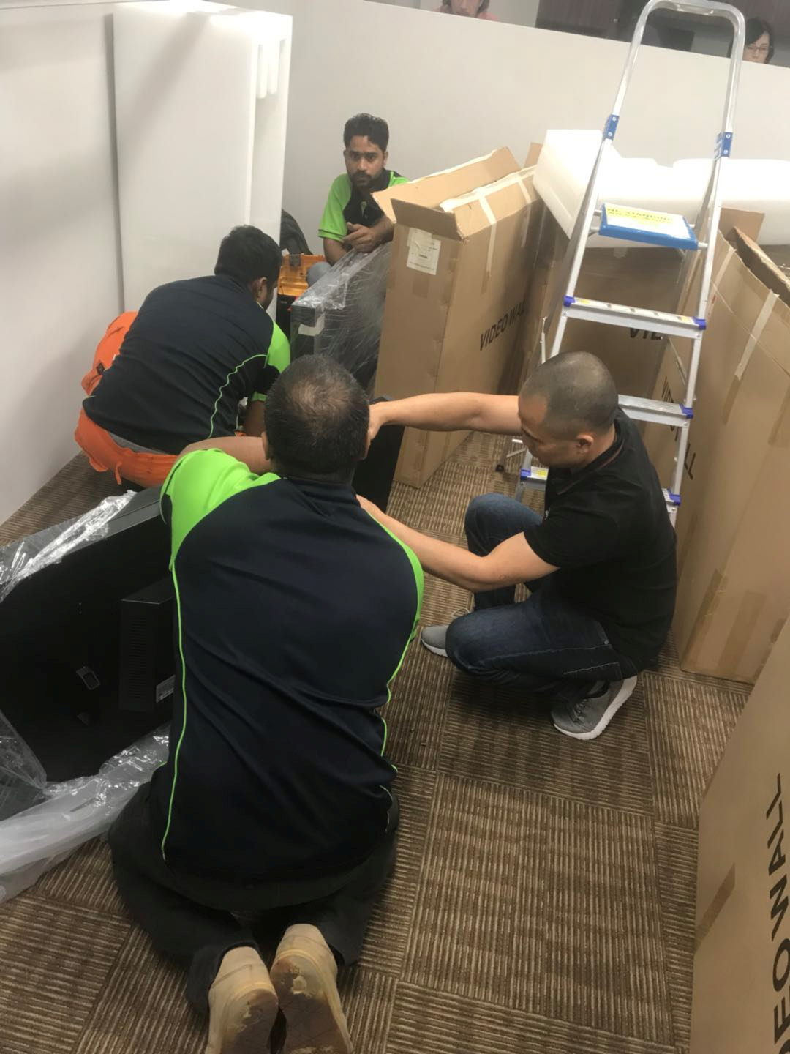
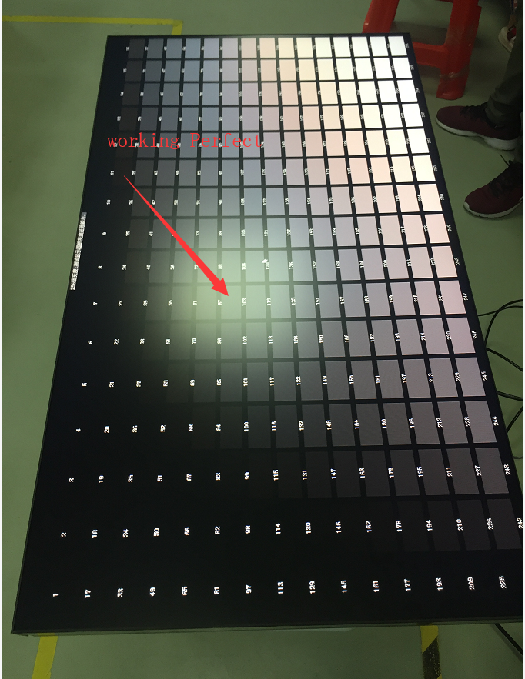
1, pls open package and Power to each video wall to checking if any defect before installation (Very Improtant), it is checking device if damage for shipping.

Slide 15
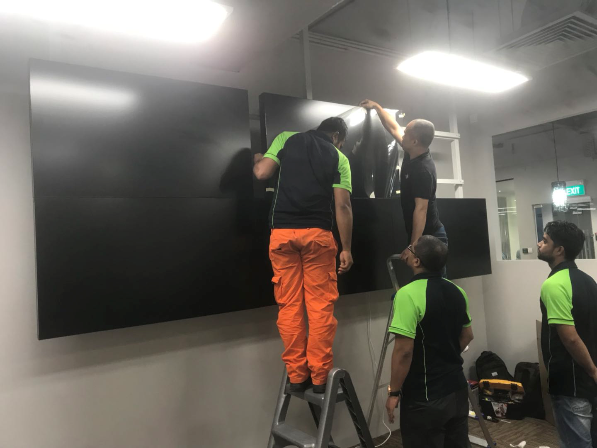
2, pls install inferior video wall firstly ,then install Above video wall

